Slide 1
Current Procedural Terminology CPT stands for Current Procedural Terminology. It is a set of codes created by the American Medical Association (AMA®) to standardize how medical procedures are recorded in a medical chart. Current procedural terminology (CPT) is a set of codes, descriptions, and guidelines intended to describe procedures and services performed by physicians and other health care providers. Each procedure or service is identified with a five-digit code. CPT codes are one of the primary ways that both public and private medical providers and healthcare institutions can report the services they have provided to patients to the government and insurance companies for reimbursement purposes. CPT codes are part of the national coding system under the Health Information Portability and Accountability Act (HIPAA). CPT codes are maintained by the CPT Editorial Board, a part of the AMA, and are updated once a year. The new codes are released annually in November and go into effect on the following January 1. The editorial board meets three times a year to review applications for new codes. CPT codes are five characters long and are usually numeric, although some may be alphanumeric depending on what category they fall into. The CPT manual is divided into three categories, each with distinct purposes outlined below:

Slide 2
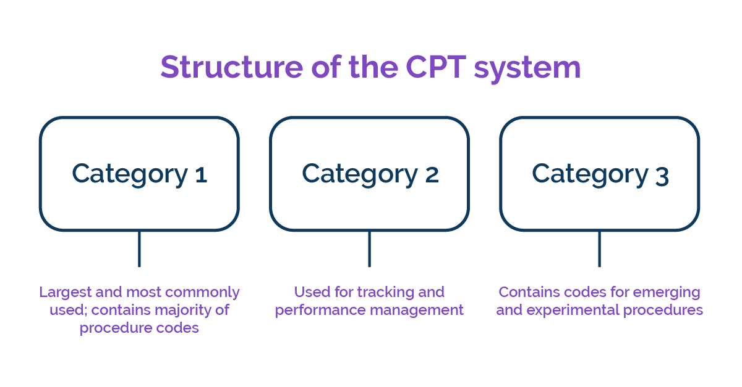
Category I Used to report the devices and drugs used during a procedure. Used to report the procedure itself to the billing department. Contains the billable codes needed for reimbursement. Category II Designed for reporting performance measures. Used to provide data to regulatory agencies. Does not contain billing codes. Primarily thought of as “quality of care” codes. Category III Codes for documenting new procedures, clinical trials and emerging technologies. Must be either added to Category I or deleted within five years of being added.

Slide 3
Implementing a Successful Revenue Cycle in Your Pain Management Practice Kim Pollock RN, MBA, CPC, in Pain Procedures in Clinical Practice (Third Edition), 2011 Kim Pollock, 7 - Implementing a Successful Revenue Cycle in Your Pain Management Practice, Editor(s): Ted A. Lennard, Stevan Walkowski, Aneesh K. Singla, David G. Vivian, Pain Procedures in Clinical Practice (Third Edition), Hanley & Belfus, 2011, Pages 53-56, ISBN 9781416037798, https://www.sciencedirect.com/science/article/pii/B9781416037798100077?via%3Dihub CPT Codes Current procedural terminology (CPT) is a set of codes, descriptions, and guidelines intended to describe procedures and services performed by physicians and other health care providers. Each procedure or service is identified with a five-digit code. The CPI manual is updated annually by the American Medical Association (AMA) and the pain management professional specialty societies contribute to CPT code development and maintenance. There are extensive service and procedure coding requirements published in the CPT manual. Providers are responsible for knowing how to accurately report, and document, CPT codes for the services rendered. There are three categories of CPT codes. Category I PT codes describe a procedure or service identified with a five-digit numeric CPT code and descriptor nomenclature; these are considered the "usual" CPT codes and are widely accepted by third party payors, Category II codes, five-digit codes with four numbers and ending with the letter "F", are intended to facilitate data collection on positive health outcomes and quality patient care. Category Ill codes, five-digit codes with four numbers but ending with the letter "T", facilitate data collection on and assessment of, new services and procedures and are used to report procedures that do not have a Category I code. Payors require a valid Category I and/or Category III code(s) for payment consideration. The various types of CPT codes are listed in Table 7-2 with a notation of the application to the pain management specialty.

Slide 4
Information Technology Standards in Biosurveillance William R. Hogan, Michael M. Wagner, in Handbook of Bio surveillance, 2006 William R. Hogan, Michael M. Wagner, CHAPTER 32 - Information Technology Standards in Biosurveillance, Editor(s): Michael M. Wagner, Andrew W. Moore, Ron M. Aryel,Handbook of Biosurveillance, Academic Press, 2006, Pages 439-452, ISBN 9780123693785, https://www.sciencedirect.com/science/article/pii/B978012369378550034X 4.1.5 Current Procedural Terminology Current Procedural Terminology (CPT) is a standard vocabulary for surgical procedures, minor procedures that physicians perform in the office, radiology tests, and a small number of laboratory tests (approximately 1,000). Whereas hospitals use ICD-9-CM for billing, physicians use CPT to bill for their services. Thus, CPT covers laboratory tests that physicians and/or their staff perform in office settings. The American Medical Association (AMA) created the first version of CPT in 1966 and until 1984 released new versions every 4 years. Since 1984 it has released a new version annually. CPT requires a license fee for its use. Because the purpose of CPT is billing, distinctions among codes often relate to the level of effort typically required to perform a procedure. For example, codes 11620 through 11624 and 11626 (six codes total) all refer to Excision, malignant lesion, except skin tag (unless listed elsewhere), scalp, neck, hands, feet, genitalia. The difference is that the codes refer to different size lesions; presumably, larger lesions require more effort to remove and thus provide greater reimbursement. You may encounter CPT-encoded procedures when obtaining claims data. If you are building or purchasing an adaptor, it should map proprietary laboratory test codes to LOINC, as LOINC is the standard for laboratory test codes. The LOINC committee, with the support of the AMA, is creating a mapping from CPT laboratory test codes to LOINC with funding from the National Library of Medicine (NLM) (Anonymous, 2004).

Slide 5
Educational and Communication Strategies and Resources Christine Waldman Wagner, in Clinical Asthma, 2008 Christine Waldman Wagner, Chapter 48 - Educational and Communication Strategies and Resources, Editor(s): Mario Castro, Monica Kraft, Clinical Asthma, Mosby, 2008, Pages 423-429, ISBN 9780323042895, https://www.sciencedirect.com/science/article/pii/B9780323042895100487 DOCUMENTATION Current Procedural Terminology (CPT) codes exist for educational and training services. These codes are applicable to asthma education. The codes are used to report services “prescribed by a physician and provided by a qualified, non-physician healthcare professional using a standardized curriculum to an individual or a group of patients for the treatment of established illness(s)/disease(s) or to delay comorbidity(s).”11 The code further states that the qualifications of the individual providing the education “must be consistent with guidelines or standards established or recognized by a physician society, non-physician healthcare professional society/association, or other appropriate source.” There is only one certifying board for asthma educators: the National Asthma Educator Certification Board (NAECB). It is essential that certified asthma educators (AE-C) work with their professional organizations to encourage third-party payers to approve reimbursement for asthma education. CPT Codes for health education are as follows: 98960: one patient for 30 minutes 98961: two to four patients for 30 minutes 98962: five to eight patients for 30 minutes These codes also specify that the education must be provided using a standardized curriculum. As with all other health care, proper documentation will be critical. The curriculum should be well documented, and the education provided. Each AE-C is responsible for developing and documenting the content of their asthma program. Figure 48-2shows an example of an asthma education flow sheet that can be used to document asthma education provided by an AE-C within the office setting.

Slide 6
Billing and Coding Sean P. Roddy MD, Sunita Srivastava MD, in Office-Based Endovascular Centers, 2020 Sean P. Roddy, Sunita Srivastava, Chapter 11 - Billing and Coding, Editor(s): Krishna M. Jain, Office-Based Endovascular Centers, Elsevier, 2020, Pages 79-88, ISBN 9780323679695, https://www.sciencedirect.com/science/article/pii/B9780323679695000113 Intravascular Ultrasound Two new CPT code descriptions were recently created that describe the IVUS transducer placement and manipulation as well as the radiologic supervision and interpretation of the IVUS imaging. CPT code 37252 denotes “Intravascular ultrasound (noncoronary vessel) during diagnostic evaluation and/or therapeutic intervention, includes radiological supervision and interpretation, when performed; initial non- coronary vessel (List separately in addition to code for primary procedure).” Examples of this procedure include intravascular ultrasound evaluation of the lower extremity during revascularization or intravascular ultrasound evaluation of the iliac vein for the treatment of May-Thurner Syndrome. CPT code 37253 denotes “Intravascular ultrasound (noncoronary vessel) during diagnostic evaluation and/or therapeutic intervention, includes radiological supervision and interpretation, when performed; each additional noncoronary vessel (List separately in addition to code for primary procedure).” CPT codes 37252 and 37253 are both add-on codes, and therefore must be reported as part of a primary procedure. They may be reported with diagnostic angiography (e.g., iliac and inferior vena cava angiography without intervention) and/or therapeutic endovascular therapy (e.g., assessment of an arterial dissection after intravascular stent deployment). Importantly, the multiple procedure payment reduction does not apply for add-on codes. CPT code 37252 is reported for IVUS in the initial vessel and may only be reported once per procedure. CPT code 37252 reflects all IVUS performed in the first vessel for the entire procedure.

Slide 7
Documentation and Reimbursement for 3D Printed Anatomic Models and Guides Jane M. Matsumoto MD, Kenneth C. Wang MD, PhD, in 3D Printing for the Radiologist, 2021 Jane M. Matsumoto, Kenneth C. Wang, Chapter 8 - Documentation and Reimbursement for 3D Printed Anatomic Models and Guides, Editor(s): Nicole Wake, 3D Printing for the Radiologist, Elsevier, 2021, Pages 99-108, ISBN 9780323775731, https://www.sciencedirect.com/science/article/pii/B978032377573100018X Future application for Category I CPT code Category III CPT codes are archived after 5 years from the initial publication or extension, unless a modification of the archival date is noted. Toward the end of the 5-year period of a Category III CPT code, application to the AMA for a Category I CPT code can be made. The bar for approval of a Category I code is much higher than a Category III code and the application must pass more rigorous criteria. Requirements include demonstration of clinical efficacy with abundant peer-reviewed literature. In addition, the service must be shown to be common practice at multiple US medical centers and there must be Food and Drug Administration clearance for all drugs and devices associated with the service. Category I applications are reviewed by the same CPT Editorial Panel that reviews the Category III applications. Once approved, the level of reimbursement of a Category I CPT code is complex and depends on several factors. The approved code is reviewed by the Relative Value Scale Update Committee (RUC) of the AMA which is an advisory group to CMS. The RUC seeks input from an Advisory Council which is made up of representatives from all medical societies and is separate from the CPT Editorial Panel. Surveys are sought on the CPT code being reviewed from members of each specialty society that perform or have an interest in the procedure or service. The RUC analyzes the data on both physician effort and the technical inputs or practice expenses needed to provide the clinical service. They then make recommendations to CMS of an appropriate RVU for the CPT code.

Slide 8
Medical and Health-Related Professions* Sandy Fritz MS, NCTMB, ... Glenn M. Hymel EdD, LMT, in Clinical Massage in the Healthcare Setting, 2008 Sandy Fritz, Leon Chaitow, Glenn M. Hymel, CHAPTER 3 - Medical and Health-Related Professions**Contributions and review of this chapter provided by W. Randy Snyder., Editor(s): Sandy Fritz, Leon Chaitow, Glenn M. Hymel, Clinical Massage in the Healthcare Setting, Mosby, 2008, Pages 54-85, ISBN 9780323039963, https://www.sciencedirect.com/science/article/pii/B978032303996350009X 1. Assign Current Procedural Terminology (CPT) when required for facility and professional fee billing. 2. Assign CPT for services and procedures and HCPCS billing codes for medical equipment and devices, with appropriate modifiers, when required for facility and professional fee billing and statistical indices. 3. Assign codes to each diagnosis ICD9CM identify and code the providers who ordered or provided services (ICD-9-CM Codes/Diagnostic) in each healthcare encounter as required for facility and professional fee billing. 4. Assemble the patient's health information by making sure that initial medical charts are complete, including the member ID number and group number to verify eligibility of benefits. 5. Follow federal and state regulations governing the assignment of any of the above codes for reimbursement. 6. Work with insurance companies on issues such as prior approval and medical necessity to ensure payment.

